Slide 1
Data Analysis fitbit user data
Yeonwoo Jo

Slide 2
AGENDA
Initial business questions
Preparing Data
​Processing Data
Analysis
​Answering business questions​

Slide 3
Business questions
What are some trends in smart device usage?
2. How could these trends apply to Bellabeat customers?
3. How could these trends help influence Bellabeat marketing strategy?

Slide 4
Preparing data
Downloaded the data regarding 30 Fitbit users for two months period from March 2016 to May 2016 from Kaggle.
https://www.kaggle.com/datasets/arashnic/fitbit?resource=download
All customers agreed to log their performances and share them.

Slide 5
Processing
Data description says it logged from March 12, 2016 to May 12, 2016, yet it started from April 12, 2016.
Renamed column names into proper format such as SampleName to sample_name
Number of customers logged were 33, not 30.
May 12, 2016, the last day seemed to be an outlier so it was removed from the analysis.

Slide 6
Analysis

Slide 7
Average daily calories and footsteps

Slide 8
Average daily exercise minutes

Slide 9
number of users logged

Slide 10
Business questions reminder
What are some trends in smart device usage?
2. How could these trends apply to Bellabeat customers?
3. How could these trends help influence Bellabeat marketing strategy?

Slide 11

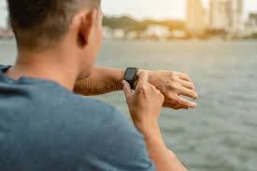
1. What are some trends in smart device usage?

Slide 12
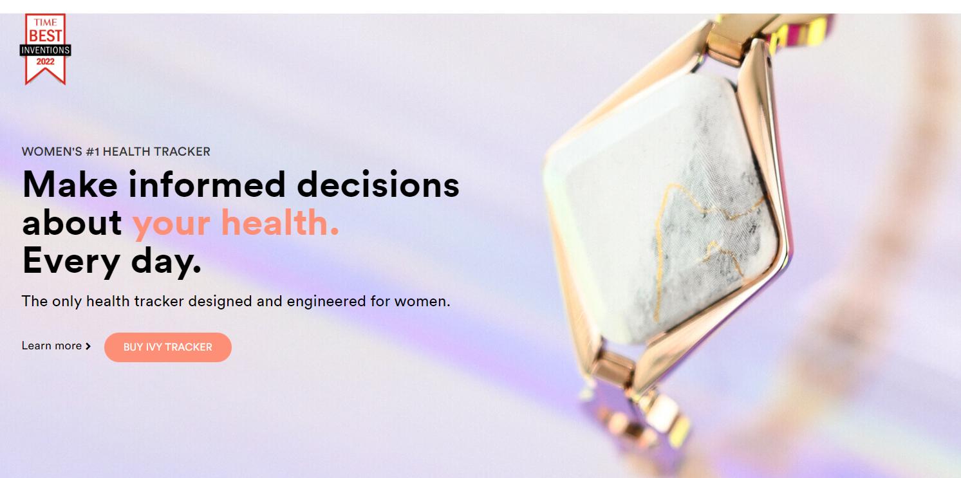
2. How could these trends apply to Bellabeat customers?

Slide 13
3. How could these trends help influence Bellabeat marketing strategy?
Appeal how Bellabeat helps to maintain constant daily routines
Bellabeat may maintain higher users than others for the same period of time

